Slide 1


Ola Bookings Report: Unlocking Operational Insights

Slide 2
Project Overview & Dataset Overview
Study Objective
Analyze Ola booking data to understand:
Operational performance
Revenue patterns
Customer behavior
Convert raw data into business
insights using EDA and dashboards.
Dataset Summary
Total Records: 103K+ bookings
Key Fields:
Booking Status
Vehicle Type
Payment Method
Ride Distance
Booking Value
Ratings

Slide 3
Business Questions
This analysis answers:
How is overall booking performance?
Success vs cancellation rate?
Which vehicles generate revenue?
Preferred payment methods?
How does revenue change over time?

Slide 4
KPI Overview
Key Metrics:
Total Bookings
Total Revenue
Avg Ride Distance
Avg Customer Rating
Total Cancellations

Slide 5
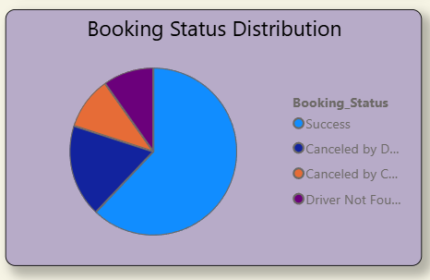
Booking Status Analyis
Majority rides completed successfully.
Customer & driver cancellations exist.
Operational improvement opportunity.

Slide 6
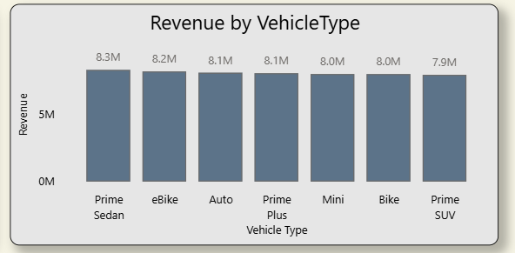
Revenue Analysis
Revenue distributed across vehicle types.
Prime Sedan contributes slightly more.
Vehicle diversity supports stable earnings.

Slide 7
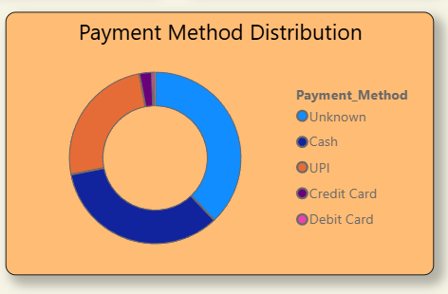
Customer Behavior Analysis
Digital payments dominate.
Cash usage comparatively lower.
Indicates strong digital adoption.

Slide 8
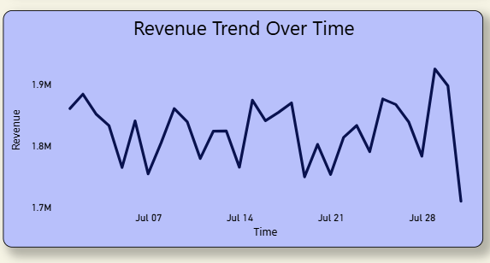
Revenue Trend Analysis
Revenue fluctuates daily.
Peaks indicate high-demand periods.
Suggests demand variation over time.

Slide 9
Conclusion & Recommendations
Key Findings
Strong booking volume & revenue
High success rate with moderate cancellations
Digital payments preferred
Recommendations
Improve driver allocation
Reduce cancellations
Promote digital payments
Monitor revenue trends
Thank You
Shreyans Jain H

